Slide 1


Slide 2

Acknowledgement of country
Connecting Communities, artwork by Alison Williams, proud Gumbaynggirr woman.

Slide 3

MORNING
Simon Cohen, Independent Review Officer - Welcome
Sarah Warren, Barrister, 9th Floor Windeyer Chambers
Adam Dent, Chief Executive, State Insurance Regulatory Authority
Dr Roger Pillemer OAM, Orthopaedic Surgeon
Independent Review Office presenters
Marilyn Cassidy, Principal Policy Officer
Ashley Payne, Principal Lawyer, ILARS
Christie Echo, A/Manager, ILARS

Slide 4
Presenting Matters Effectively Before the Personal Injury Commission
Sarah Warren

Slide 5

Presenting Matters Effectively Before the Personal Injury Commission
Sarah Warren
Barrister
Liability limited by a scheme approved under Professional Standards Legislation
Notes:
I just want to highlight that I am happy to take questions at any time through the presentation via the chat/message function. Although if I do not see your message immediately, I will try to address it as soon as I see it.
I will tend to use phrases that are more specific to personal injury matters so please let me know if there is anything you wish to be expanded further

Slide 6
The first step in getting to a paperless society is getting rid of the lawyers…
–Carl Stoddard, American Author
Liability limited by a scheme approved under Professional Standards Legislation
Notes:
Some say that the first step in getting to a paperless society is getting rid of the lawyers - well not some, specifically Carl Stoddard, an American author.
Hopefully as the past couple of years have shown, we are proving Carl to be wrong in this respect.
I utilise this quote as the Personal Injury Commission is paperless in a sense in that all of the documents need to be lodged through the portals and online systems. Meaning that it is based on the electronic document system.

Slide 7



Liability limited by a scheme approved under Professional Standards Legislation
Notes:
Since covid-19 threw us out of the courtrooms and into other spaces, including working from our kitchen tables or bedrooms, moving towards paperless litigation has been a necessity. Although as many of you know, the Commission (and its prior iterations especially in workers compensation) relied on electronic lodgement of documents for proceeding. Covid pushed us more to reducing the associated paper and printing and also running matters remote.
The benefit is that now we can work from almost anywhere
The downside is that now we can work from almost anywhere …

Slide 8
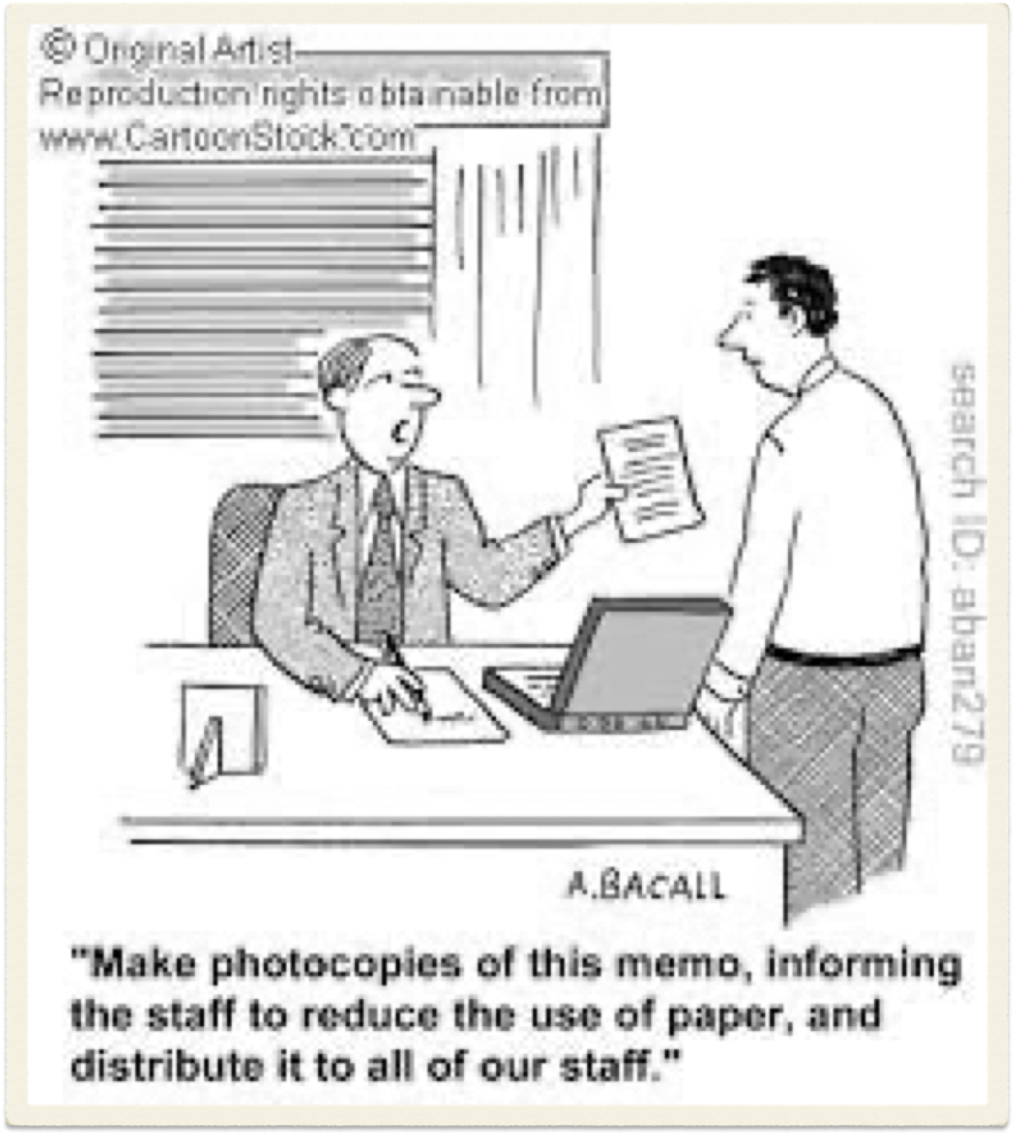
Presenting Matters Effectively Before the Personal Injury Commission
_____________________________
This presentation will cover the following topics:
Proceedings in the Personal Injury Commission – the Rules
Workers Compensation Division of PIC
Motor Accidents Compensation Division of PIC
Liability limited by a scheme approved under Professional Standards Legislation
Notes:
Today I am not going to go into all of the ways to run litigation without paper - I just don’t have the time and I don’t pretend to hold all the answers or expertise in that
What I will be running through is honing specifically into personal injury matters and the different requirements that you ought to be aware of and some practical tips that may help you along the way
I will run through:
proceedings in the Personal Injury Commission
Workers Compensation Division of PIC
Motor Accidents Compensation Division of PIC

Slide 9
Section 3 - Personal Injury Commission Act 2020
Objects of Act
s.3(c) to enable the Commission to resolve the real issues in proceedings justly, quickly, cost effectively and with as little formality as possible
Liability limited by a scheme approved under Professional Standards Legislation

Slide 10

THE RULES
Liability limited by a scheme approved under Professional Standards Legislation

Slide 11

  Procedural Direction PIC3 - Documents and late documents
Applies to both divisions
Directs your attention to the application legislation and rules:
  Section 3 and 42 of the Personal Injury Commission Act 2020
  Section 290 of the Workplace Injury Management and Workers Compensation Act 1998
  Rules 17, 18, 33, 66, and 67 of the PIC Rules
Liability limited by a scheme approved under Professional Standards Legislation
Notes:
Section 3 of the PIC Act is the object of the Act which I took you through on an earlier slide
Section 42 relates to the guiding principle
Section 290 of the Workplace Injury Management and Workers Compensation Act 1998

Slide 12
    Guiding Principle
Section 42 of the Personal Injury Commission Act 2020 sets out the guiding principle is to ‘facilitate the just, quick and cost effective resolution of the real issues in the proceedings’
Liability limited by a scheme approved under Professional Standards Legislation

Slide 13
  Workers Compensation Division
Section 290 of the Workplace Injury Management and Workers Compensation Act 1998
Deals information exchange between the parties
Requires the parties to provide to the other party and the Commission such information and documents as the Commission rules require
Can be penalties or costs implications
Liability limited by a scheme approved under Professional Standards Legislation
Notes:
290 Information exchange between parties
(1) When a dispute is referred for determination by the Commission, each party to the dispute must provide to the other party and to the President, as and when required to do so by the Commission rules, such information and documents as the Commission rules require.
(2) A party to a dispute who fails without reasonable excuse to comply with a requirement of this section is guilty of an offence.
Maximum penalty—50 penalty units.
(3) Any document or information that a party to a dispute has failed to provide in contravention of this section cannot be admitted on behalf of the party in proceedings on the dispute before the Commission.
(4) Subsections (2) and (3) do not apply if the party is a worker unless it is established that the worker was represented by a legal practitioner or agent (as defined in section 131) at the relevant time.
(5) The Commission rules may provide for exceptions to subsection (3). In particular, the Commission rules may authorise the Commission to permit the admission in proceedings before the Commission in specified circumstances of a document or information that would otherwise be not admissible under that subsection.
(6) If the President is satisfied that an applicant has failed without reasonable excuse to comply with a requirement of this section, the President may do any one or more of the following—
(a) refer the matter to the Authority,
(b) note the matter in a certificate issued by the President in respect of the dispute (together with details of the documents or information to which the failure relates),
(c) order that a specified amount or proportion of the costs that would otherwise be recoverable by the party in connection with the referral of the matter to the Commission are not recoverable

Slide 14
    PIC Rules
Rule 17 - requires the use of the approved forms or risk being rejected
Rule 66 - use the approved form for applications
Rule 18 - any document in a language other than English must be accompanied with an English translation and translator declaration
Liability limited by a scheme approved under Professional Standards Legislation
Notes:
Must use the correct forms or risk the application being rejected - which is important if there are time limitation issues at play
66 Application to commence applicable proceedings
(1) Applicable proceedings may be commenced by lodging an application for the proceedings concerned in the approved form.
(2) The application must—
(a) set out, or be accompanied by, the particulars and information required by the approved form relevant to the resolution of the real issues in the proceedings, and
(b) be lodged within the period specified by enabling legislation or these Rules for applications of the kind concerned, and
(c) comply with other procedural requirements for the application.
(3) The President may refuse to accept an application that does not comply with a requirement of this Part.
Rule 18 Language of documents
A document in a language other than English lodged with or served on the Commission must be accompanied by—
(a) (b)
an English translation, and
a declaration in the approved form by the translator that the translation is an accurate translation.

Slide 15
    PIC Rules
Rule 33 - production of recordings, films and electronic documents
Applies to -
            - video recording
            - audio recording
            - a film or photograph
            - a medical image
Liability limited by a scheme approved under Professional Standards Legislation
Notes:
33 Production of recordings, films and electronic documents
(1) This rule applies to each of the following documents if a party to applicable proceedings proposes to rely on the document—
(a) a video recording,
(b) an audio recording,
(c) a film or photograph,
(d) medical imaging, including an x-ray, CT scan, MRI scan or ultrasound,
(e) a document produced or received by electronic means.
(2) If a document to which this rule applies consists of a surveillance recording or image, an investigator’s report concerning the material—
(a) must clearly and unambiguously identify the recording or image, and
(b) is, for the purposes of subrule (3), taken to be part of the document.
(3) A document to which this rule applies is, subject to this rule, a document for the purposes of rule 67.
(4) For a document referred to in subrule (1)(d)—
(a) the original film or scan is not to be lodged with the Commission, and
(b) the lodging and service of a list describing and clearly identifying the film or scan satisfies the lodging and service requirements of rule 67, and
(c) the original film or scan may be taken or delivered to a medical assessor conducting a medical assessment.

Slide 16
    PIC Rules
Rule 67 - material to be lodged in proceedings
- must be relevant to the resolution of the real issues
- documents must have been provided to the other parties
- deals with admission of late documents - to be lodged not later than 3 working days before teleconference/hearing
Liability limited by a scheme approved under Professional Standards Legislation
Notes:
67 Material to be lodged in applicable proceedings
(1) A party to applicable proceedings must lodge and serve on the other parties, with an application to commence proceedings or a reply to an application, the following—
(a) the information and documents relevant to the resolution of the real issues in the proceedings on which the party proposes to rely that—
(i) are in the possession or control of the party, and
(ii) that have not been lodged by a party in the current proceedings,
(b) the information or documents required to be provided with the application or reply by—
(i) the approved form for the application or reply, or
(ii) these Rules, or
(iii) the procedural directions.
(2) Subject to subrules (3) and (4), a party may not introduce evidence that has not been—
(a) lodged and served as required by subrule (1), or
(b) provided to another party as required by enabling legislation or these Rules.
(3) If a party to applicable proceedings wishes to rely on a document not lodged and served in compliance with subrule (1), the party must—
(a) as soon as practicable after becoming aware of the document or obtaining possession of the document, serve a copy on all other parties, and
(b) not later than 3 working days before a medical assessment or teleconference, on one occasion only and by the approved form, lodge all documents not previously lodged, and
(c) not later than 3 working days before a hearing, on one occasion only and by the approved form, lodge all documents not previously lodged.
(4) The appropriate decision-maker for the applicable proceedings may, if it is satisfied that it is necessary to do so in the interests of justice, allow a party to introduce evidence that the party would be prevented from introducing because of the operation of subrule (2) if—
(a) the party complies with subrule (3), or
(b) the appropriate decision-maker gives the party leave to lodge additional documents.
(5) Subrules (3) and (4) do not prevent a party from lodging additional documents in motor accident proceedings at any time before the assessment if—
(a) all the parties to the proceedings consent to their lodgement, or
(b) they are lodged at the direction of the Commission, or
(c) it is in the interests of justice for them to be lodged.

Slide 17
  Procedural Direction PIC3 - Documents and late documents
Commission specifically requires the following material in the Workers Compensation Division
  Signed statement of the worker
  Signed statement from witness - especially if oral evidence is required from witness
  Schedule of earnings (weekly compensation disputes)
Liability limited by a scheme approved under Professional Standards Legislation
Notes:
Material in the workers compensation division
12. The Commission requires the early exchange of information between parties (s 290 of the 1998 Act).
13. In addition to the requirements of rule 67 of the PIC Rules, the Commission specifically requires the following information be lodged and served in workers compensation proceedings:
(a) where proceedings are commenced by a worker, a signed statement of the worker;
(b) where oral evidence is required from a witness, a signed statement from that witness, and
(c) where the dispute concerns weekly payments of compensation, a schedule of earnings, in the prescribed form, must be provided by the employer or their representative. See Procedural Direction PIC5 – Schedule of earnings for further information on the preparation of a schedule.
14. A party will be prevented from relying on a document where it is not provided in accordance with section 290 of the 1998 Act and the PIC Rules, unless leave is granted by the Commission in accordance with rule 67(2) of the PIC Rules.

Slide 18
  Procedural Direction PIC3 - Documents and late documents
Commission specifically requires the following material in the Motor Accidents Division
  Schedule of damages with the application
  Schedule of damages with the reply
  Schedule of earnings (statutory benefits dispute)
Liability limited by a scheme approved under Professional Standards Legislation
Notes:
Material in the motor accidents division
15. In addition to the requirements of rule 67 of the PIC Rules, any specific material required by a form approved by the President, the enabling legislation or PIC Rules must be lodged with the Commission.
16. In a claim for damages, a schedule of damages must be provided with the application. If a party disputes the accuracy of the schedule of damages lodged with the application, they must lodge a schedule of damages with their reply, in accordance with rule 100 of the PIC Rules.
17. In proceedings where statutory benefits are in dispute, a schedule of earnings, in the prescribed form, must be provided with the application. If a party disputes the accuracy of the schedule, they must lodge a schedule of earnings with their reply, in accordance with rule 68 of the PIC Rules. See Procedural Direction PIC5 – Schedule of Earnings for further information on the preparation of a schedule.

Slide 19
Is there an order that it should be in?
Liability limited by a scheme approved under Professional Standards Legislation
Notes:
Yes funnily enough the Commission has gone to the effort of setting out in the procedural direction the preferred order for supporting documentation. This was carried over from the Workers Compensation Commission days
However, can I say that it is best to have it as easy to read as possible beginning with the claimant’s statement (which is in line with the direction). This sets out the claimant’s story as the first document read - which is what you want

Slide 20
  Order of documents
witness statements of the claimant and any other witnesses;
claim forms;
dispute notices;
schedule of damages;
schedule of earnings;
relevant correspondence;
list of payments;
Liability limited by a scheme approved under Professional Standards Legislation
Notes:
This is where applicant

Slide 21
  Order of documents
factual investigation reports;
medical reports;
medical investigation reports;
clinical notes
financial records
Liability limited by a scheme approved under Professional Standards Legislation
Notes:
;Financial records – only relevant if there is a dispute about PIAWE or if the claimant has been working and it is relevant to the dispute
wage records;
pay slips;
bank statements;
tax returns, and
award information.

Slide 22
  Order of documents
Documents within each category to be in chronological order - with first in time placed first
Paginated
Recorded in the form in the supporting documents list
Liability limited by a scheme approved under Professional Standards Legislation
Notes:
19. Documents within each of the above categories should be arranged in chronological order, with the first in time placed first. Documents should be recorded in the relevant Commission form and appropriately paginated.
20. Care should be taken to ensure that all documents attached are relevant to the resolution of the real issues in proceedings, rather than attaching all documents in the possession of a party. For example, financial records are generally unlikely to be relevant for the purposes of a medical assessment.

Slide 23
What goes in the statement?
Liability limited by a scheme approved under Professional Standards Legislation
Notes:
Yes the procedure direction even goes as far as to point out what the Commission thinks should go into a statement

Slide 24
  Procedural Direction PIC3
21. The timely and effective resolution of matters before the Commission requires that the statements provided by parties contain all appropriate and relevant facts, together with a sufficiently detailed history. Any statement relied on by a claimant should include, but not be limited to:
(a) work history;
(b) the circumstances of the injury;
(c) information regarding medical treatment received in respect of the injury, and
(d) a summary of any ongoing effect/s of the injury.
Liability limited by a scheme approved under Professional Standards Legislation
Notes:
Obviously this is a simplistic list of what should go into a statement
What needs to go into the statement should be relevant to the issue in dispute
It is the opportunity to tell the Member the story so make sure that you let them know what they need to know to make a decision your favour
Have a think about what the nature of the dispute is and what the Member needs to know in order to determine the matter.
The statement should be taken seriously as it is the person’s evidence. It should not be a summary of the medical evidence and it should not verging into submissions.

Slide 25

  Schedules of Earnings
Procedural Direction PIC5 deals with schedules of earnings
Applicable in workers compensation matter weekly compensation disputes
Motor accident - 2017 Act statutory benefit disputes
Damages claims - schedule of damages
Liability limited by a scheme approved under Professional Standards Legislation

Slide 26

Late Documents at PIC
Applications to admit late documents
Set out the reasons for the lateness of the documents
Set out the reasons for its admission in the proceedings
Workers compensation - must be lodged no later than 3 working days prior to teleconference/arbitration/medical assessment
Liability limited by a scheme approved under Professional Standards Legislation
Notes:
Tip that they need to be done in workers comp at least 3 days prior otherwise it will be rejected by the portal and then it is painful to try to get it to the Member last minute - they will not get the opportunity to be on top of the material

Slide 27
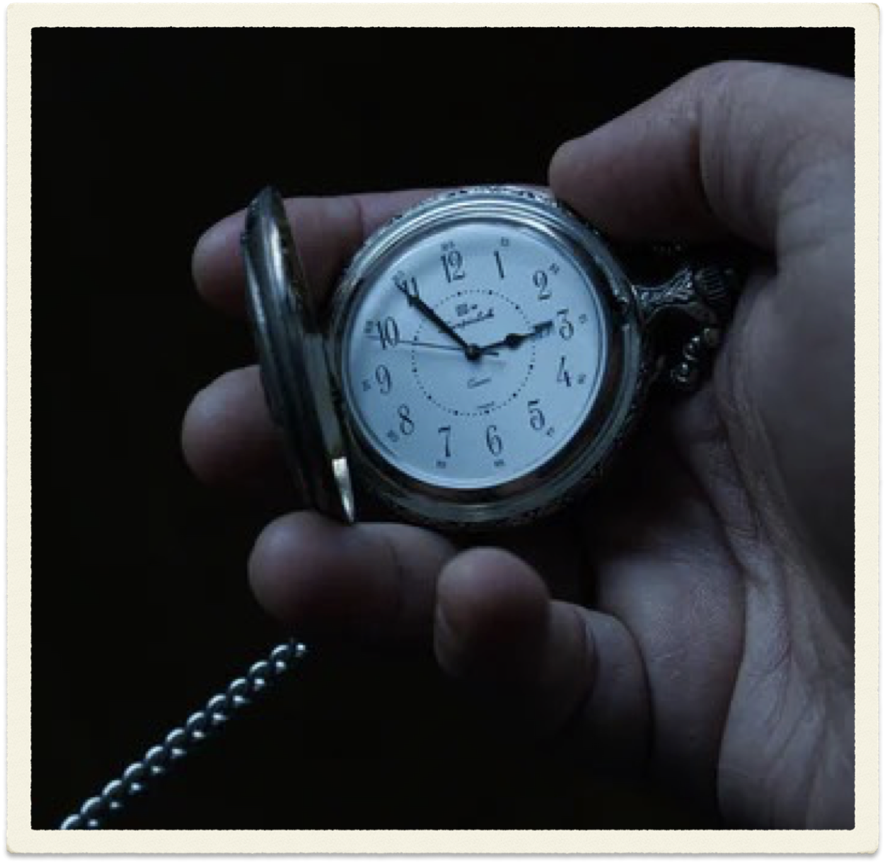
Late Documents at PIC
Motor accidents - late documents can be lodged at any time:
  With the consent of all parties
  Lodged at the direction of PIC
  It is in the interests of justice for it to be lodged
Liability limited by a scheme approved under Professional Standards Legislation
Notes:
Proceedings in the motor accidents division
30. In accordance with rule 67(5) of the PIC Rules, a party to motor accident proceedings may lodge additional material with the Commission at any time before the assessment, if:
(a) all parties to the proceedings consent to its lodgment, or
(b) it is lodged at the direction of the Commission, or
(c) it is in the interests of justice for it to be lodged.
31. An application to admit late documents must be provided to the other parties to the proceedings before lodgment with the Commission.
32. The application will be referred to the President for consideration. The President will provide the other party with an opportunity to lodge written submissions in response to the application to admit late documents.
33. In determining an application for leave to admit late documents, the President will consider if it is in the interests of justice for the documents to be lodged, having considered the objects of the enabling legislation, the PIC Act, and all of the circumstances of the application and the claim.

Slide 28
  TIPS
Liability limited by a scheme approved under Professional Standards Legislation
Notes:
Ok so now these are definitely not hard and fast rules and I also do not pretend to hold the answers or secrets but here are some tips I can share about proceedings in the Personal Injury Commission. Things that I learned as a solicitor, when the Workers Compensation Commission first moved to online filing, things I have picked up as counsel running matters, especially when I have done so from an electronic brief, and things I have picked up from others
The main thing with this is trying to make the decision makers job to determine the claim in your favour as easier as possible. There is an old saying, ‘Happy wife, happy life’ - now I haven’t come up with some little quote that works the same, but imagine, happy judge/decision-maker, happy client/lawyers - or something along those lines

Slide 29
REMOVE DUPLICATES
Liability limited by a scheme approved under Professional Standards Legislation
Notes:
Ok I know, I know - but this is one that we all come across regularly.
This covers things including - if the report appears already in the bundle as part of other clinical records, it does not need to go in again

Slide 30

  TIPS
If the other party has already included the document, do not include it again
Liability limited by a scheme approved under Professional Standards Legislation
Notes:
I know the first bullet point kind of covers over what I have already said in the last slide. However, it is relevant to state specifically. If you are concerned that you want to note that you rely on a document say already in the applicant’s ARD (for workers compensation matters), in the list of documents in your reply, refer to the document but in the page reference column, put a reference to where it appears in the applicant’s attached documents
This can be also done in motor accidents, although hasn’t quite come across into that division

Slide 31

Remove blank pages
Check all the pages are the correct way
Liability limited by a scheme approved under Professional Standards Legislation
Notes:
Removing blank pages - this seems to be an issue with hospital clinical records. For the bundle that will form part of the evidence, remove any pages that are blank - including blank forms
Flipping and rotating pages can be painful in electronic documents but it is worse to have a decision-maker trying to figure it out at the other end especially after you have already paginated and cross referenced the bundle

Slide 32

  TIPS
Organise the clinical records
Remove irrelevant tests results
Remove irrelevant medical reports
Liability limited by a scheme approved under Professional Standards Legislation
Notes:
Organising the clinical records branches across into a few things that make it easier for everyone reading the documents.
Obviously you cannot control how doctors print out the notes (although those out there that have the magic touch, feel free to share your magic tips)
However, we have all seen the mess of reports and scan results that can come attached to a print out of the consultation notes. The best way to help a decision maker find the right documents, is for these records to be in chronological order, for duplicates to be removed, and remove the irrelevant materials
There are concerns about that - serve the full copy of the clinical records, if the other party wants to put anything additional in, it can be added to their bundle. In the meantime, you are reducing the irrelevant materials that go before the decision-maker and they will be thankful for it

Slide 33

  TIPS
Documents in chronological order
Not always the rule - splitting into specific doctors and then date order
Specifically refer to treating reports and separate them out
Liability limited by a scheme approved under Professional Standards Legislation
Notes:
It may seem simple to say this but it helps with being able to read in the order of events
This can be difficult when it comes to medical reports as you sometimes are required to sort in doctor order and then in chronological order but at least it is still then telling the story of that doctors treatment in order
Imagine it is like telling a story, on behalf of your client, you want the reader to be able to easier follow along with the story you want them to - you don’t want them getting distracted by side characters and irrelevant information

Slide 34

  TIPS
Written submissions - add hyperlink to the case citation
Providing list of authorities with PDF copies of cases
Chronology can be your friend - especially if cross referenced to the paginated annexures
Liability limited by a scheme approved under Professional Standards Legislation
Notes:
Adding hyperlinks to written submissions enables the decision-maker to easily access the case. However, when it comes to needing to provide copies of reported decisions - collate the pdf copies of the case in one paginated bundle with the list of authorities, where necessary (more so for Court than PIC)

Slide 35

Anyone have any tips they wish to share?
Liability limited by a scheme approved under Professional Standards Legislation
Notes:
To help save others from the paper vortex, does anyone have any tips they wish to share.

Slide 36
SARAH WARREN
BARRISTER
www.9windeyer.com.au
Email: swarren@windeyerchambers.com.au
Liability limited by a scheme approved under Professional Standards Legislation

Slide 37
Holding Regulated Entities to Account: SIRA’s Enhanced Focus on Driving Better Scheme Outcomes
Adam Dent

Slide 38
Holding Regulated Entities to Account: SIRA’s Enhanced Focus on Driving Better Scheme Outcomes
June 2023
Adam Dent
Chief Executive

Slide 39






Overview of Insurance Schemes
Workers Compensation insurance
4.5 million workers covered
100,000 claims each year
$4.4 billion in premiums collected
CTP insurance
5.9 million Green Slips each year
45,000 claims since 2017
$2.9 billion in premiums
Home building compensation
20,000 builders covered
1,700 notifications of loss and claims in 2021
$240 million in premiums collected
Insurers
SIRA supervises 80 insurers across three schemes
Employers
300,000 employers covered
Providers
$1 billion spent on healthcare
15,000 SIRA-approved providers
750 permanent impairment assessors

Slide 40

Regulatory activity across CTP
1 June 2022 – 31 May 2023
7
Letters of Censure
2
Civil Penalty
26
Current Remediation plans
4
Successful Prosecutions
SIRA regulates six licenced insurers in the NSW CTP scheme

Slide 41




Regulatory activity across WC
1 June 2022 – 31 May 2023
9
Regulatory letters issued to the Nominal Insurer
5
Special licence conditions imposed
4
Group self-insurer licences granted
3
Successful Prosecutions
1035
Total Penalties Issued (s155 and Double Avoided Premium)
156
Total Cautions/Warnings/
Notification of Breach
153
Employer improvement notices issued by SIRA Inspectors
343
Total s161 and s174 Notices

Slide 42
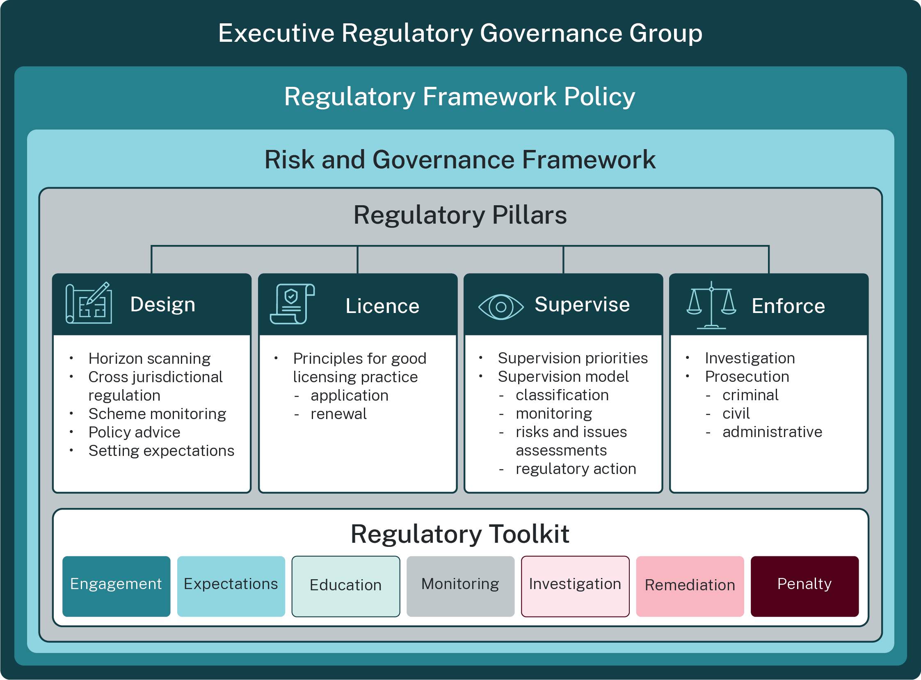

Slide 43
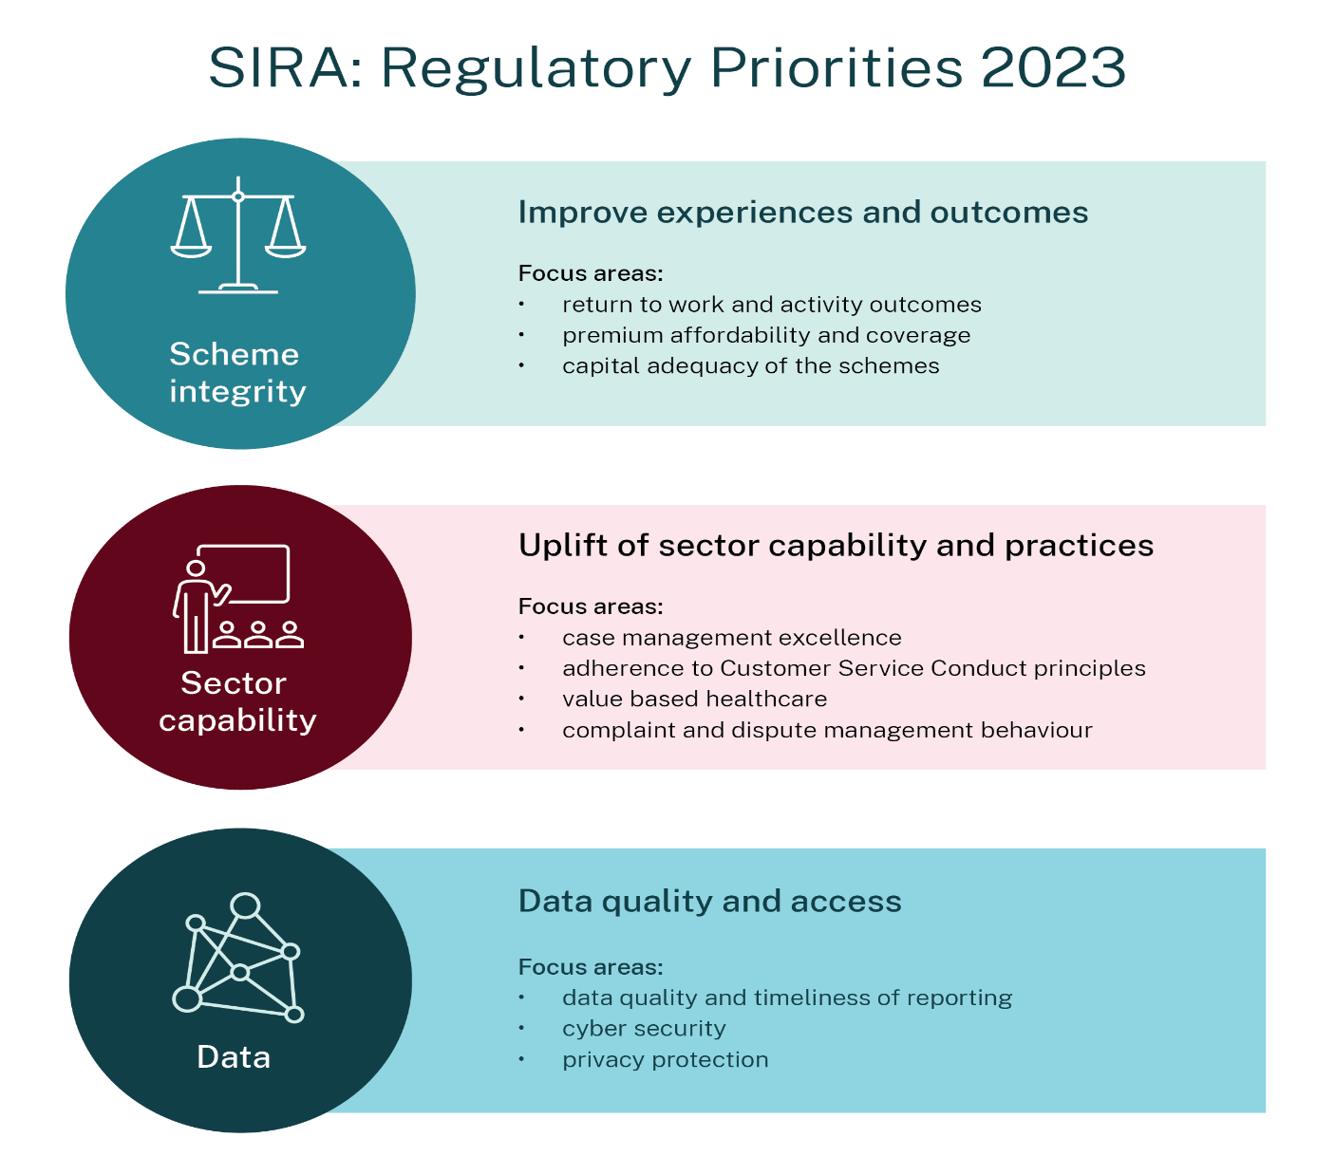

Slide 44
Thank you
Questions?

Slide 45
Discussion of Frequently Asked Questions Towards a Better Understanding of Medicolegal Reports
Dr Roger Pillemer OAM

Slide 46
“Discussion of Frequently Asked Questions”
Towards a Better Understanding of Medico-legal Reports
IRO Sydney Seminar: Wednesday 14 June 2023

Slide 47
Frequently Asked Questions:
Basic medical terminology
Differences in impairment ratings
Carpal tunnel syndrome – is this work related?

Slide 48
Frequently Asked Questions:
Basic medical terminology

Slide 49
Frequently Asked Questions:
Basic medical terminology
• Symptoms and signs

Slide 50
Frequently Asked Questions:
Basic medical terminology
• Symptoms and signs
symptoms - subjective
signs - subjective
- objective

Slide 51
Frequently Asked Questions:
Basic medical terminology
• Symptoms and signs
symptoms - subjective
signs - subjective
- objective
•Arthritis: what does this term mean?

Slide 52
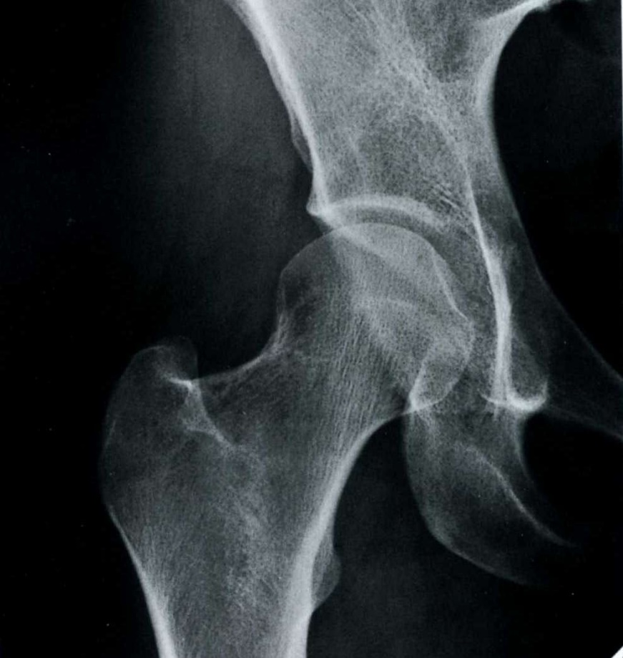

Slide 53
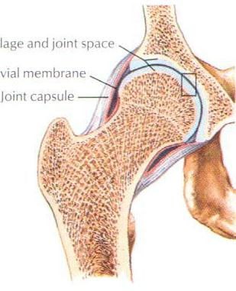

Slide 54
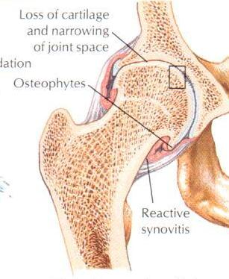

Slide 55
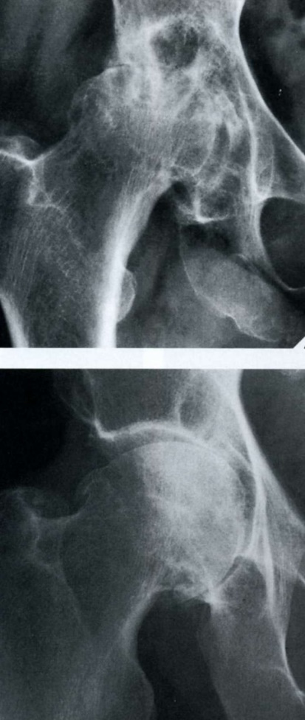

Slide 56
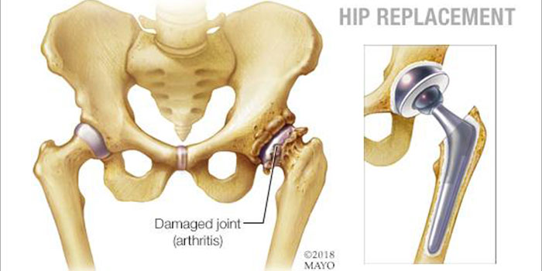

Slide 57
Types of Arthritis:
A: Inflammatory
B: Osteoarthritis

Slide 58
Types of Arthritis:
A: Inflammatory
- R.A., psoriasis, gout, sepsis
B: Osteoarthritis

Slide 59
Types of Arthritis:
A: Inflammatory
- R.A., psoriasis, gout, sepsis
B: Osteoarthritis
i) Overuse – sports, obesity, aging, (idiopathic)

Slide 60
Types of Arthritis:
A: Inflammatory
- R.A., psoriasis, gout, sepsis
B: Osteoarthritis
i) Overuse – sports, obesity, aging, (idiopathic)
ii) Post-traumatic

Slide 61
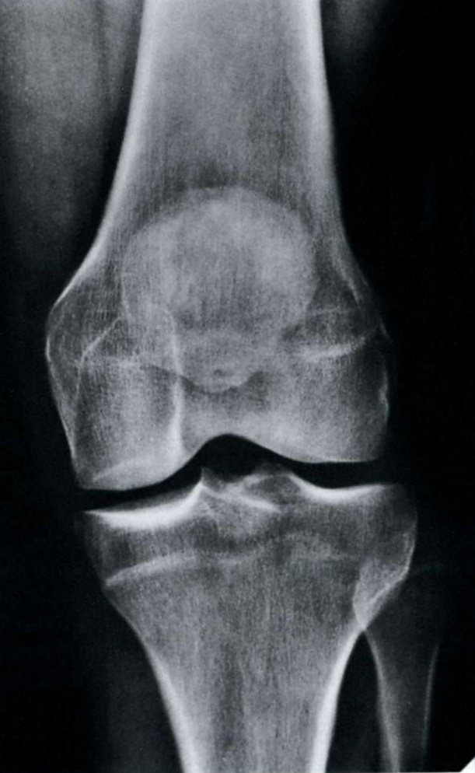

Slide 62
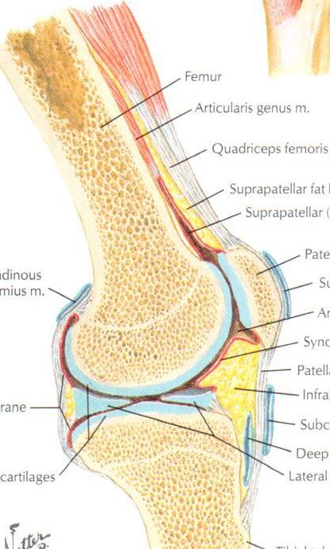

Slide 63
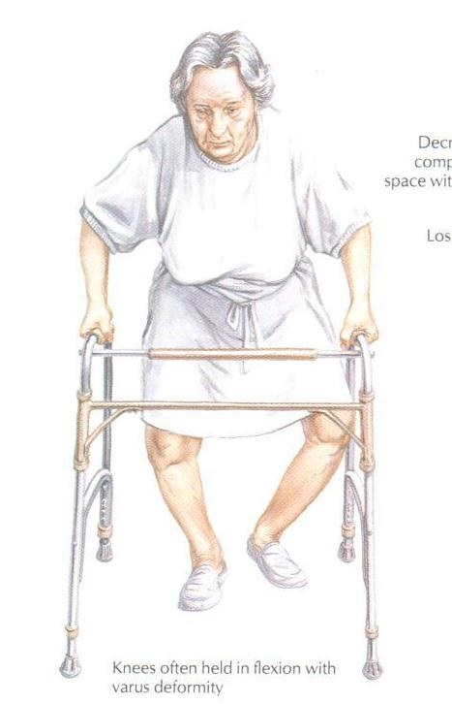
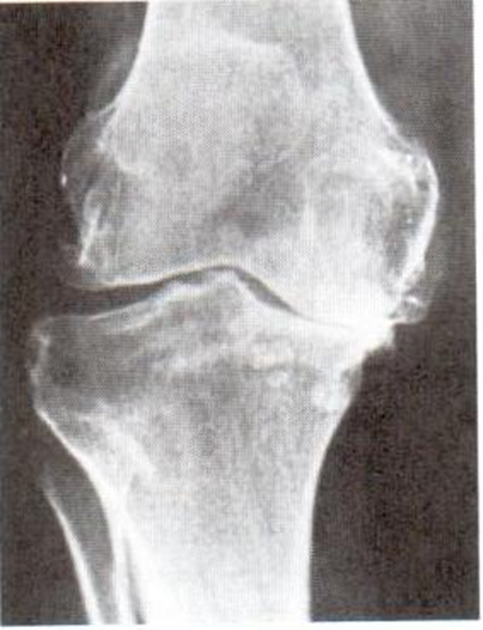
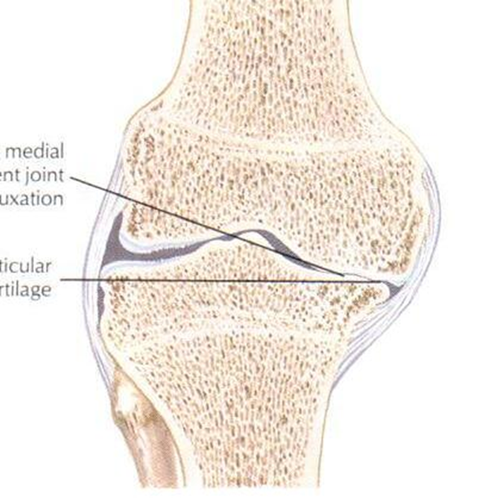

Slide 64
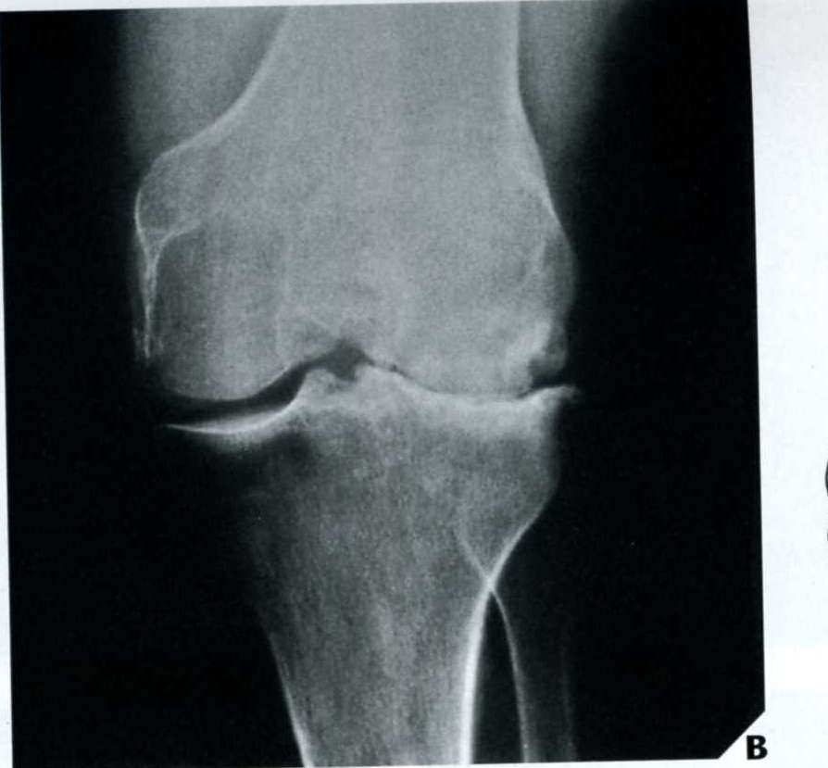

Slide 65
Frequently Asked Questions:
Basic medical terminology
• Symptoms and signs
symptoms – subjective
signs - subjective
- objective
•Arthritis: what does this term mean?
•Eponyms: naming of tests and signs

Slide 66
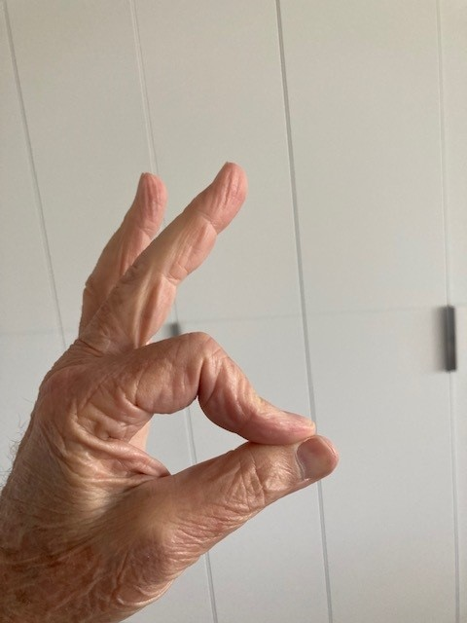

Slide 67
Frequently Asked Questions:
Basic medical terminology
Differences in impairment ratings

Slide 68
Frequently Asked Questions:
Basic medical terminology
Differences in impairment ratings
- different doctors, different findings

Slide 69
Frequently Asked Questions:
Basic medical terminology
Differences in impairment ratings
- different doctors, different findings
- different day, less painful, different findings

Slide 70
Frequently Asked Questions:
Basic medical terminology
Differences in impairment ratings
- different doctors, different findings
- different day, less painful, different findings
- condition may have improved/worsened (not MMI)

Slide 71
Frequently Asked Questions:
Basic medical terminology
Differences in impairment ratings
- different doctors, different findings
- different day, less painful, different findings
- condition may have improved/worsened (not MMI)
- bias

Slide 72
Bias:
“We are all biased”

Slide 73
Bias:
“We are all biased”
Robert Burns 1759 -1796

Slide 74
Robert Burns
“Oh would some Power the gift give us,
To see ourselves as others see us”

Slide 75
Frequently Asked Questions:
Basic medical terminology
Differences in impairment ratings
Carpal tunnel syndrome – is this work related?

Slide 76
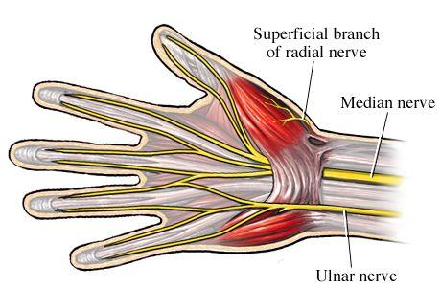

Slide 77
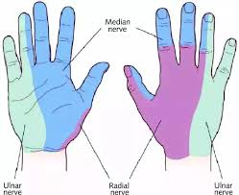

Slide 78
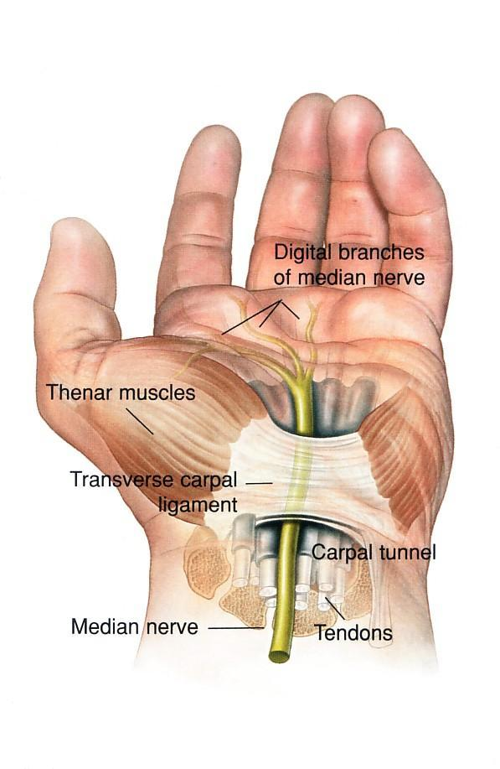

Slide 79
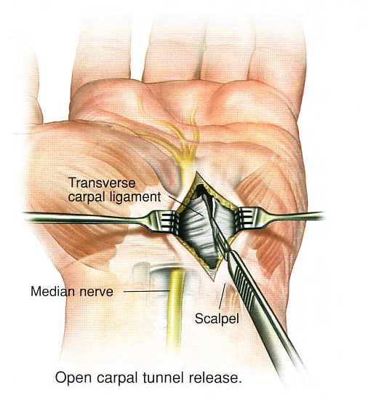

Slide 80
Opportunities for Early Solutions in Disputed Workers Compensation Claims
Independent Review Office presenters
  Ashley Payne, Principal Lawyer, ILARS
  Christie Echo, A/Manager ILARS
  Marilyn Cassidy, Policy Manager

Slide 81
Overview
Ashley Payne – Foundations of Early Solutions and its operation with IRO
Christie Echo – Early Solutions Outcomes and Data
Marilyn Cassidy – The future of Early Solutions & s60 Early Solutions Pilot Program

Slide 82
Foundations of Early Solutions and its operation within IRO
  Ashley Payne, Principal Lawyer, ILARS

Slide 83
Statutory foundations of IRO Early Solutions Work
One of IRO’s statutory functions is to seek solutions to disputes.
Clause 9(2) to Schedule 5 to the PIC Act provides that one of the purposes of ILARS is:
"…to provide assistance in finding solutions for disputes between workers and insurers.”

Slide 84
Early Solutions under the ILARS Funding Guidelines
ILARS Funding Guidelines have been developed in accordance with Clause 10 of Schedule 5 of the PIC Act.
Part 1.6 of the ILARS Funding Guidelines confirm IRO’s Commitment to;
  “just, quick and cost-effective resolution of issued in claims and disputes.”
"

Slide 85
Types of Early Solutions
Two types of early solutions:
  No response to claim (NRTC)
  Other Early solutions intervention

Slide 86
No Response to Claim (NRTC) Early Solutions
No Response to Claim matters are referrals that are made from ILARS to the IRO Solutions team when an insurer has not responded to a claim or review request.
Part 3.3.6 of the ILARS Funding Guidelines outlines the process.
The IRO will generally not grant funding to proceed to the Personal Injury Commission during NRTC period.

Slide 87
Other early solutions on ILARS Funded Grants
Early Solutions Process through ILARS
ILARS identify & refer to Solutions team
ILARS review applications for funding
ILARS provide insurer response to Approved Lawyer
Solutions team contact the insurer for a response

Slide 88
Examples of Types of Early Solutions Matters Identified by ILARS
Follow ups for further s78 Notices
Defective s78 notices or those with obvious error
Where the quantum of claim is under $3,000
Matters where there is a small difference in WPI assessments, and which don’t cross a threshold
Matters where previous requests for documents from an insurer have gone unanswered

Slide 89
The Early Solutions Process & No Response to Claim (NRTC) Process
  Christie Echo, A/Manager, ILARS

Slide 90
The NRTC Process
ILARS refer matter to Solutions Team
Solutions Team contacts the Insurer
Insurer responds to Solutions
Solutions convey Insurer response to ILARS
If matter not resolved, ILARS make funding decision

Slide 91
Timeliness of NRTC
IRO's existing early solutions process (including NRTC) is at minimal delay to the parties – Insurer responses to referrals from Solutions are typically received within 2 business days
92% of NRTC cases are closed in 7 days or less
Well established and timely process made possible through high participation and co-operation of insurers

Slide 92
Early Solution Outcomes (NRTC)
Resolved Benefit The claim is accepted, an adverse decision is overturned
Resolved Action The enquiry results in an action taken by the insurer
Resolved Information Where the NRTC allegation is not substantiated, the insurer has not received the claim

Slide 93
Early Solution Outcomes – case studies
Early resolution of Permanent Impairment claim
WCD outcome – increase in weekly benefits
Soft decline over surgery

Slide 94
The future of Early Solutions & s60 Early Solutions Pilot Program
  Marilyn Cassidy, Policy Manager, SPS

Slide 95
The future of Early Solutions & s60 Early Solutions Pilot Program
What?
Treatment expenses disputes
Why?
Practical considerations
Potential benefits
Notes:
Why?
IRO committed to finding early solutions
Scheme objectives:
WIM 1998 s.3(b) - 'prompt treatment of injuries' AND 'to be fair, affordable, and financially viable'
PIC Act s.3(c) - 'to resolve the real issues in proceedings justly, quickly, cost effectively’
Practical considerations:
Often more limited issues
Potential benefits:
Faster access to treatment, earlier return to work and daily activities
Less adversarial
Narrow the scope of disputes
Reduced costs
Average costs:
Resolved before PIC - $3,125.46
In the PIC - $8,826.65
At teleconference - $8,290.79

Slide 96
The future of Early Solutions & s60 Early Solutions Pilot Program
Why?
ILARS data:
  Stage 3 grants for s.60s disputes in 2022 – 277
  Outcome not favourable to worker – 16
  Average days to resolution
    Prior to PIC – 277 days
    Teleconference – 421 days
    Following Hearing – 538 days
Notes:
ILARS data:
Injured workers are highly successful in the PIC and out of it
Grants finalised in PIC 1 January 2022 to 31 December 2022:
Total of 277 grants
16 did not achieve an outcome favourable to the worker
13 matters discontinued with no result
2 matters had a COD for the employer
Average days from date of grant to date of dispute resolution:
Prior to PIC – 255
Teleconference – 421
Settlement at conference – 485
Following hearing COD for worker – 538
Discontinued with no result – 772

Slide 97
The future of Early Solutions & s60 Early Solutions Pilot Program
How will it work?
Process
Escalation or extension of time
Timelines
Notes:
Process:
NRTC
Approved Lawyer requests stage 3 funding
Principal Lawyer determines matter meets pilot program criteria
Internal referral to Solutions
Request to insurer to review
Insurer reviews and responds
Matter resolved or stage 3 funding granted
Escalation:
Insurer fails to respond
Insurer response unsatisfactory
Extensions:
Both parties agree
Timelines:
All goes well 2-6 business days
Escalation required 2-12 business days

Slide 98
The future of Early Solutions & s60 Early Solutions Pilot Program
Eligibility criteria
Liability is disputed (ss78, 287A) - insufficient evidence
No dispute about other entitlements (eg lump sum)
Not impacted by s.59A
Proposed treatment supported by treating/assessing health professional

Slide 99
The future of Early Solutions & s60 Early Solutions Pilot Program
Success - what could it look like?
Insurer review process
Increase proportion of matters resolving before stage 3 funding is granted
Facilitating PIC objectives
Data on efficiency and effectiveness of early solutions programs
Notes:
Insurer review process
Insurers have claim reviewed by someone with focus, expertise and authority
Reduce the number of matters needing to go to the PIC
Where matters do go to the PIC:
Encourage parties to clarify issues in dispute
Improve prospects of resolution at an early stage of proceedings
Reduce the number of matters which need to be discontinued

Slide 100
The future of Early Solutions & s60 Early Solutions Pilot Program
When?
Commencing Spring 2023
For 6 months
Further details are coming!

Slide 101
How to help IRO help you deliver early Solutions to Injured Workers - Approved Lawyers
ILARS Grant Number (if applicable)
A clear summary the issues and proposed solution
All necessary information (copy of claim, communication serving the claim, details of how, when and to what address the claim was made)
Details of any follow up with insurer (when/how/who)
If there has been any acknowledgement by the insurer or their representative about the claim/issue (including date and nature of communication)

Slide 102
How to help IRO help you deliver Early Solutions - Insurers
If you are relying on a document/decision, please provide it.
If a claim has been overlooked in error, please provide a date for when the claim will be determined and when it is determined please provide a copy of the decision once issued.
If you consider you are inside timeframes, please provide a brief timeline establishing that.

Slide 103
CLOSING COMMENTS
Simon Cohen
Lunch Break: 12.10pm – 1.10pm
  We ask that you be seated for the afternoon session promptly at 1.10 – thank you

Slide 104

Lunch break
12.10pm – 1.10pm

Slide 105
Afternoon
Mary Maini, Group Executive Workers Compensation, icare
Panel:
  Chris Wheeler, Chris Wheeler Consulting
  Jacqueline Barker, Customer Care Manager, Employers Mutual Limited
  Arthur Fogarty, Solicitor, Lamrocks
  Benjamin Walker, A/Manager Solutions, Independent Review Office
  Jay Gleeson, NSW Service Delivery Manager Critical Incidents, Benestar
  Tegan Cone, Industrial Services and Bargaining, Australian Services Union NSW and ACT
Tatjana Jokic, Managing Director, JK Corporate Resourcing (for the Australian Rehabilitation Providers Association)
Melissa Hirst – Director, Strategy, Policy and Support – Closing Comments

Slide 106
The Nominal Insurer Improvement Program
(content not for publication)
Mary Maini

Slide 107
Panel: Meeting the Challenge of Challenging Conduct – Providing Effective Services and Ensuring Staff Wellbeing when Injured People Act
Unreasonably

Slide 108
Panel:
Chris Wheeler, Chris Wheeler Consulting
Jacqueline Barker, Customer Care Manager, Employers Mutual Limited
Arthur Fogarty, Solicitor, Lamrocks
Benjamin Walker, A/Manager Solutions, Independent Review Office
Jay Gleeson, NSW Service Delivery Manager Critical Incidents, Benestar
Tegan Cone, Industrial Services and Bargaining, Australian Services Union NSW and ACT

Slide 109
It Pays to Care
Tatjana Jokic

Slide 110

It Pays to Care
Presented by Tatjana Jokic

Slide 111

Introduction to ARPA
What we know
Current landscape
Trends – IRO submissions & complaints
It Pays to Care paper
Case Study
Learnings
Agenda

Slide 112
Represent over 90% of all WRP.
Assisting with RTW and quality of life.
Liaison with all stakeholders.
Increase in complaints, whilst RTW rates decline.
Introduction to ARPA
Notes:
ARPA represents over 90% of all workplace rehabilitation providers along with other rehabilitation providers.
Try to get as close to pre-injury/pre-illness quality of life and/or work type.
Despite all this, we are still seeing a rise in complaints whilst RTW rates continue to decline.

Slide 113
Rise in IRO / ILARS applications sought and approved.
Typically, by the insurer in the claim/RTW process.
We know lawyers can refer for independent opinions
In most cases, these were avoidable scenarios if claims decision showed more care.
What we know
Notes:
What we are seeing is that the applications and approvals for IRO / ILARS continues and in some instances continues to grow.
This means that something has / has not happened through the claims process that has led to the need for independent legal advice or support, or a lodgement of a complaint.
Many times this is due to actions or inactions that were avoidable.

Slide 114
Work injuries bring with them a greater risk of delayed recovery compared to non-work injuries.
Increase in psychosocial problems.
Current Landscape
Notes:
WC injuries typically take longer to heal and are more expensive.
Many reasons for this that I don’t have time to go into today.
There is an increase in psychosocial problems and it forms part of the systemic issues or failures we see in the current schemes. Much of this is interpretation …

Slide 115
IRO provided an independent complaints service to more than > 30 000 injured workers last year.
IRO assisted >110 000 workers access to independent legal assistance.
>140 000 separate ILARS grants granted.
86% of Personal Injury Commission (PIC) presentations led to the worker improving their position.
Primary psychological injury claims continue to rise - 19.8% of applications (3,824) in FY2021/22.
Grants concerning primary psychological injury have risen consistently in the past two years at a rate of 25 %.
Trends
IRO Annual Report 2021/22
Notes:
The message here is:
There are MANY complaints and legal intervention.
86% of PIC involvement led to a better position for the IW. This means that the IW had not been treated fairly or appropriately.
Nearly 20% of all applications for ILARS are for claims where the primary injury is psychological. Most of these claimants are not in a position where they are equipped to be justifying/arguing for the right to lodge and be treated with equity.
These psychological injury claims seeking ILARS grants continues to grow at a rate of 25%... That’s a ¼ of all claims complaints!!

Slide 116


IRO Annual Report 2021/22
IRO 2021/22
Notes:
This is from the IRO Annual Report 21/22
Nearly 8000 complaints to IRO
Top WC issues – all regarding access to the financial benefits (liability and payments)
Top CTP issues – 2/3 relating to the financial benefits in addition to treatment
80% of complaints are resolved
40% led to action/benefit in favour of the worker
This is important, as there is still a perception that the majority are malingerers or disingenuous. This is not the case. The minority may be, however, we need to start treating the majority as thought their injury is real, requiring the support that their treaters are recommending… it pays to care…

Slide 117

As we move the focus being on both WC and CTP claimants, it is important that we reference the It Pays to Care research.
It Pays to Care research paper outlines three key principles:
Tailored person-specific treatment and management.
Multi-stakeholder approach.
Importance of early intervention.
It Pays to Care
Notes:
IRO is focusing on both WC and CTP moving forward
It Pays to Care research and paper outlines 3 key principles.
These are not new, nor are they extraordinary in any way. We should be doing this already… why aren’t we??
This is basic case management 101

Slide 118
How to apply It Pays to Care?
The Australasian Faculty of Occupational and Environmental Medicine (AFOEM) are leading the call to improve the health and recovery outcomes for people who experience a work injury.
Evidenced-based principles about how these barriers can be addressed.
This paper describes ways to improve scheme delivery in the four central work injury domains: leadership and regulation, case management, the workplace and healthcare.
It Pays to Care
Notes:
AFOEM, who is also behind the HBGW initiative, are calling for the improvement of health and recovery outcomes for people who have a work injury.
They drive the notion of health benefits of good work, which leads into the call for the improvement of this cohort’s treatment as the care provided differs once you are in the insurance scheme of WC/CTP.
The research shows that following evidence based principles will lead to an improvement in the scheme/s.
Addresses the 4 central work injury domains:
Leadership & regulation
Case Management
The workplace
Healthcare

Slide 119
It Pays to Care Principles
A values and principles-based research paper which describes healthy insurance schemes and sets out why “it pays to care”.
Systems approach which addresses modifiable psychosocial determinants of health can achieve improvements in work disability and costs between 20-40%.
Failure to consistently implement evidence-based systems approach to psychosocial risks.
It Pays to Care
Notes:
IPTC takes a systems approach.
We know that we need a systems approach rather than individualistic.
If we don’t start to look at this from a systems approach, it will continue to have strong and negative impacts on both the claimants and the business sector.

Slide 120
ARPA are involved in developing national consistency to support injured claimants access early support.
On 24/03/2023, stakeholders came together for round table discussions to discuss a consistent framework for the treatment of claimants within the WC and CTP schemes.
It Pays to Care
Notes:
On 24/03/2023, stakeholders came together for round table discussions, to begin the process of a nationally consistent framework and ethos around the treatment of workers within the workers compensation and CTP schemes.
Opportunity to hear from the regulators, insurers, HBGW representatives regarding the pain points and begin the process of developing a nationally consistent framework from which we all work.

Slide 121
Our goals:
Consistent triage for psychosocial risk
Consistent education of insurers
Consistent regulation
It Pays to Care
Notes:
So why is ARPA involved in arranging this?
Our goals are:
Consistent triage for psychosocial risk
Consistent education of insurers
Consistent regulation

Slide 122
For Lawyers
In many cases, the psychosocial barriers It Pays to Care seeks to address are linked to the same unnecessary claims handling methods that propel IRO complaints from a worker.
It Pays to Care
Notes:
The principles are simple… yet far from simple in reality.
We can see a direct link between the principles defined in the IPTC and the basis for the IRO complaints discussed earlier.

Slide 123
Case study to highlight the reality and learnings of workplace rehabilitation and workers compensation.
Name and main identifiers have been changed.
Current and real claim …
Case Study - Jody
Notes:
I thought I would walk you through a case study to highlight the reality of what I have just outlined…

Slide 124

She can’t be that unwell!
Why is nothing working?
Why are the doctors asking for all that?
Why aren’t we following clinical benchmarks?
          We aren’t going to approve for ALL that!
Case Study - Jody

Slide 125

The silence…
It’s frustrating
I’m forgotten
Just reply!!
They’re not on my recovery team!!
As a nurse, I’m a carer and it’s expected that I provide a high level of care. Why am I not getting the same level of care??
Case Study - Jody
Notes:
Jody is a NURSE!
Why doesn’t Jody get the same level of care as an injured worker as we provide patients in hospital??

Slide 126
40-year-old female
Nurse
Working 6 days straight
Only attended work, no social or personal events attended during this period
Contracted COVID 02/2022
Unfit to work 12 months
RTW after 12 months
SDs were simple tasks, repetitive work – need to consider cognitive loading rather than only physical
Case Study - Jody
Notes:
COVID – remember I was questioned why we weren’t following clinical benchmarks??
A direct quote was “surely there is some research that outlines what is realistic with regards to treatment”
Hmmm… no there isn’t! We are in unchartered waters… the world is in the same boat!

Slide 127
Referral sent to WRP by GP
Ax’s completed by WRP
INAx (including physical / psychological ax’s)
ADL
Liaison with referrer (insurer)
Recommendation to have aids to allow for return to avocational roles (mother, wife, friend) & RTW
Contact with all treating parties
Ensure psychologically safe
Case Study - Jody

Slide 128
All ADL’s declined
Turning point psychologically for worker
Inability to understand actions (perceived injustice)
Sense of loss / grieving role
Worker seeks legal support (turning point for claim)
WRP to focus on workers mental health state
WRP to focus on educating insurer & employer
Case Study - Jody
Notes:
We have 2 turning points
Psychological turning point for IW – she was ‘broken’ at this stage.
Legal support (ILARS grant) turning point for claim management.

Slide 129
ILARS grant sought and approved.
Legal advice and support.
Independent ADL ax and report.
Defendant legal review – recommendations included: approval of all ADL recommendations with a firm recommendation that the insurer begin to ‘do their job’ and take a ‘care bear’ approach.
Case Study - Jody
Notes:
Lucky for me I had a good relationship with the insurer rep (not CM) who advised me that their legal representatives had advised them as the insurer to “do your job” and start taking a “care bear approach”.

Slide 130
It does pay to care
Avoidable
Claim now has a secondary psychological component
Worker disengaged from process, now there is a WIFM outlook
Additional treaters involved
Claim more costly
Compliant with ALL requests and continues to be compliant in order to benefit herself
Learnings
Notes:
So… it does pay to care.
So much of what then happened could have been avoided.
From both a human cost and financial cost perspective!

Slide 131

Questions??
ARPA | 1300 886 901
Notes:
I hope this has given you a very brief overview of the IPTC research and paper and how it applies to all that we do… there are some basic principles that, if applied, will have monumental impact.
Any questions…

Slide 132
CLOSING COMMENTS
Melissa Hirst

